Slide 1
The Dots Game

Slide 2
Game Description
Played on a rectangular array of dots
A move: connect two adjacent dots into a horizontal or vertical line
A move which completes a square (4 dots) gives that player the square plus a mandatory immediate additional move
When all squares are filled, the winner is the player with the most squares
Notes:
What do you want from this course?
What do you want from programming?

Slide 3
Game Description - continued
To show the square as belonging to the player, their initials or marker is placed in the square
Notes:
What do you want from this session?
What do you want from programming?

Slide 4
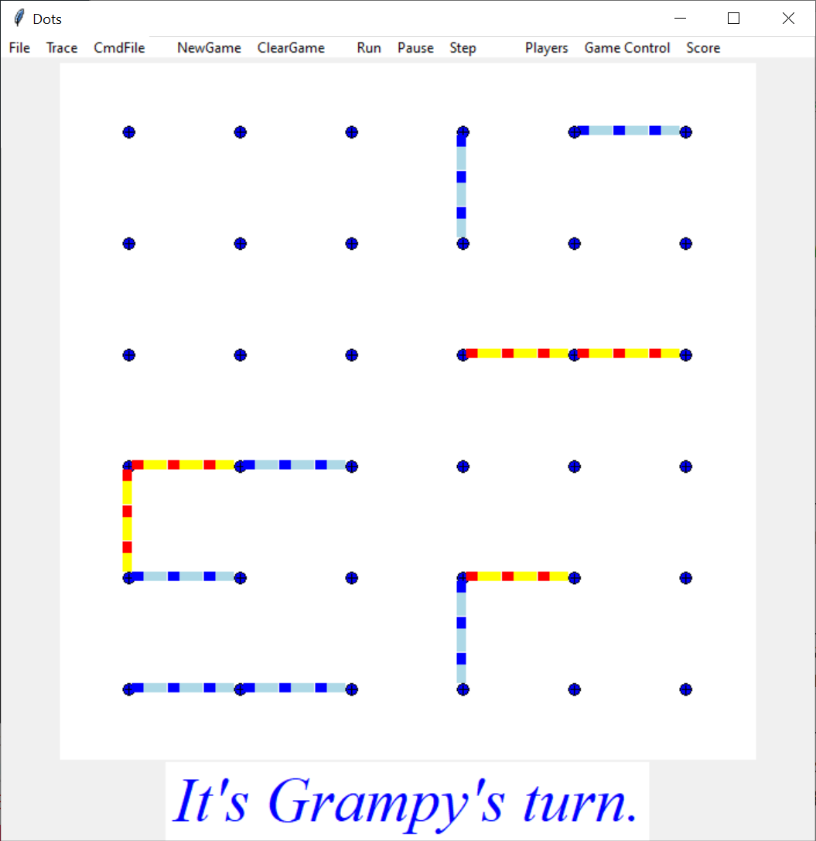
Game in Play – before first square
Notes:
What do you want from this session?
What do you want from programming?

Slide 5
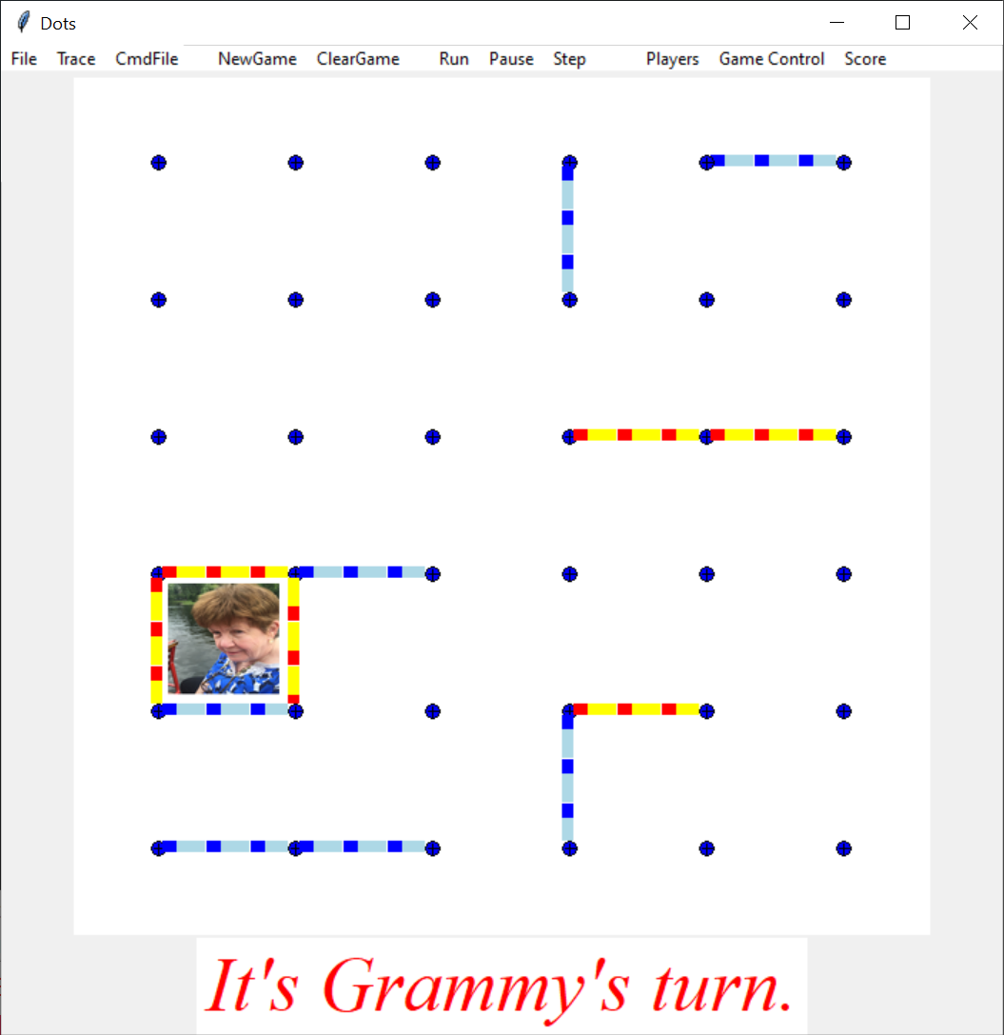
Game in Play – after first square
Notes:
What do you want from this session?
What do you want from programming?

Slide 6
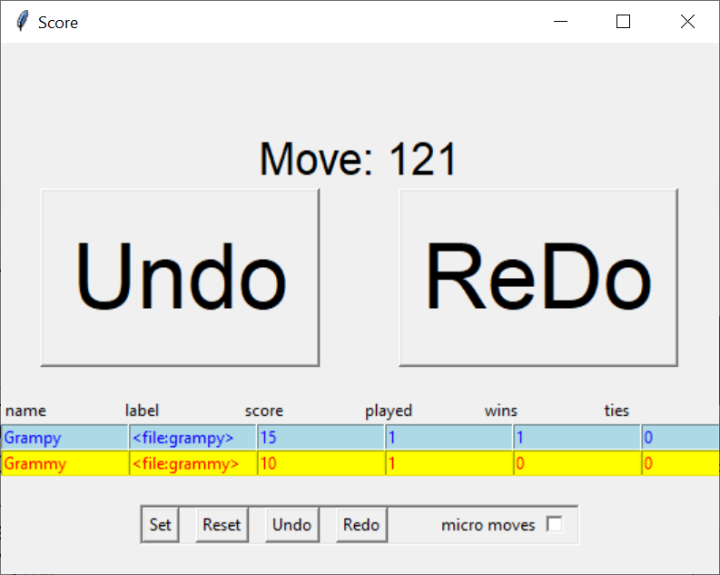
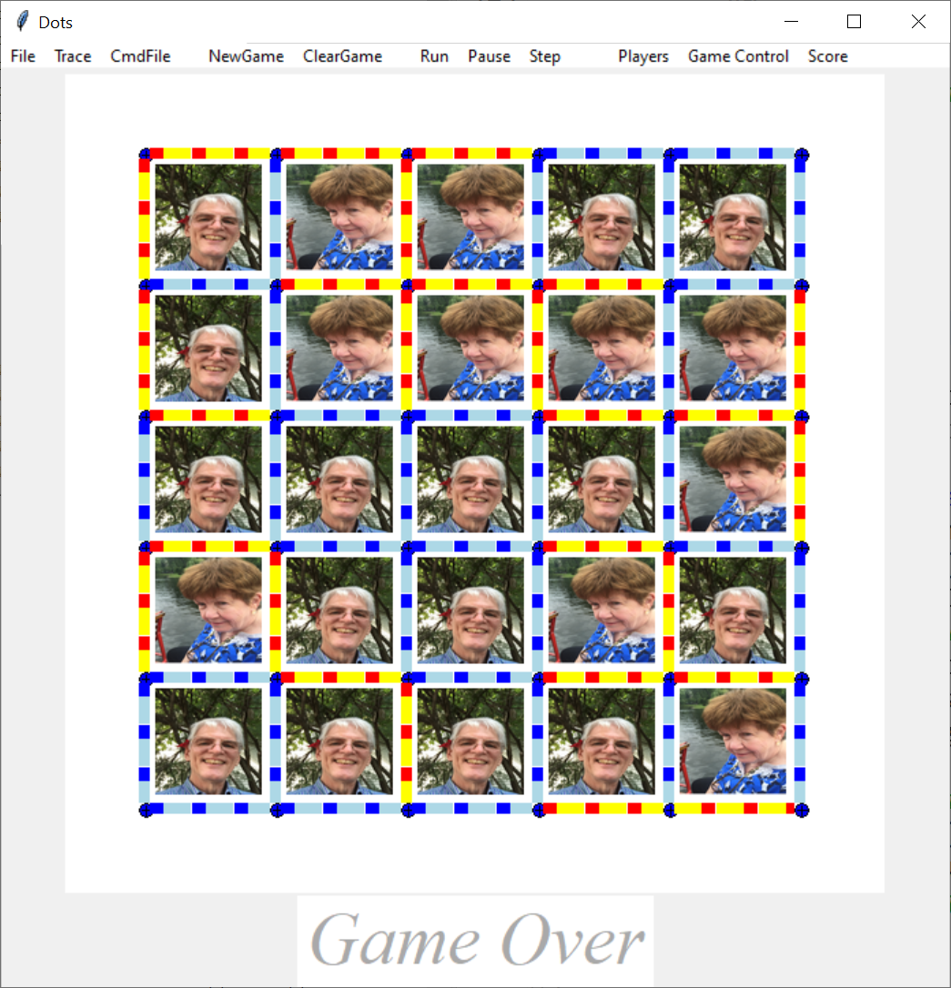
Game End
Notes:
What do you want from this session?
What do you want from programming?

Slide 7
Game Description - continued
Note, that once placed, the player who made the move has no effect
The line colors is just for informational purposes
Notes:
What do you want from this session?
What do you want from programming?

